Slide 1
Scalable Data Analytics
SENG 550
AKA. Big Data - Data Engineering
Armin Zirak

Slide 2
Data Pipelines (Cont.)
12

Slide 3
Reverse ETL
Quick Reminder: ETL/ELT moves data from sources (databases, APIs, files) into a centralized warehouse or lake for analytics and reporting.
Sometimes the transformed data needs to go back into those source systems to be actionable.

Slide 4
Reverse ETL
For example, we’ve created the below orders_eriched table inside the data warehouse but we want to ship it back to PostgreSQL to allow OLTP queries be efficiently running on it.
While the data warehouse acts as a consolidated data storage to apply all transformations, we need to allow users run OLTP queries on the eventual dataset. So, that dataset neets to go back to the source system which is PostgreSQL in this example.
The red arrow that does this is called reverse ELT!
Data warehouse
orders
cleaned
orders
enriched & cleaned
orders
orders table (PostgreSQL)
extract/load
clean
enrichment
reverse ETL

Slide 5
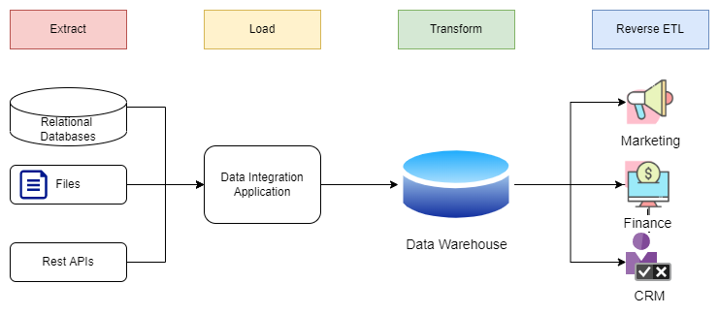
Reverse ETL
Reverse ETL is the process of moving data from a central data warehouse back into operational systems, like a database.
Reverse ETL is a specific type of data serving where the target is a database.

Slide 6
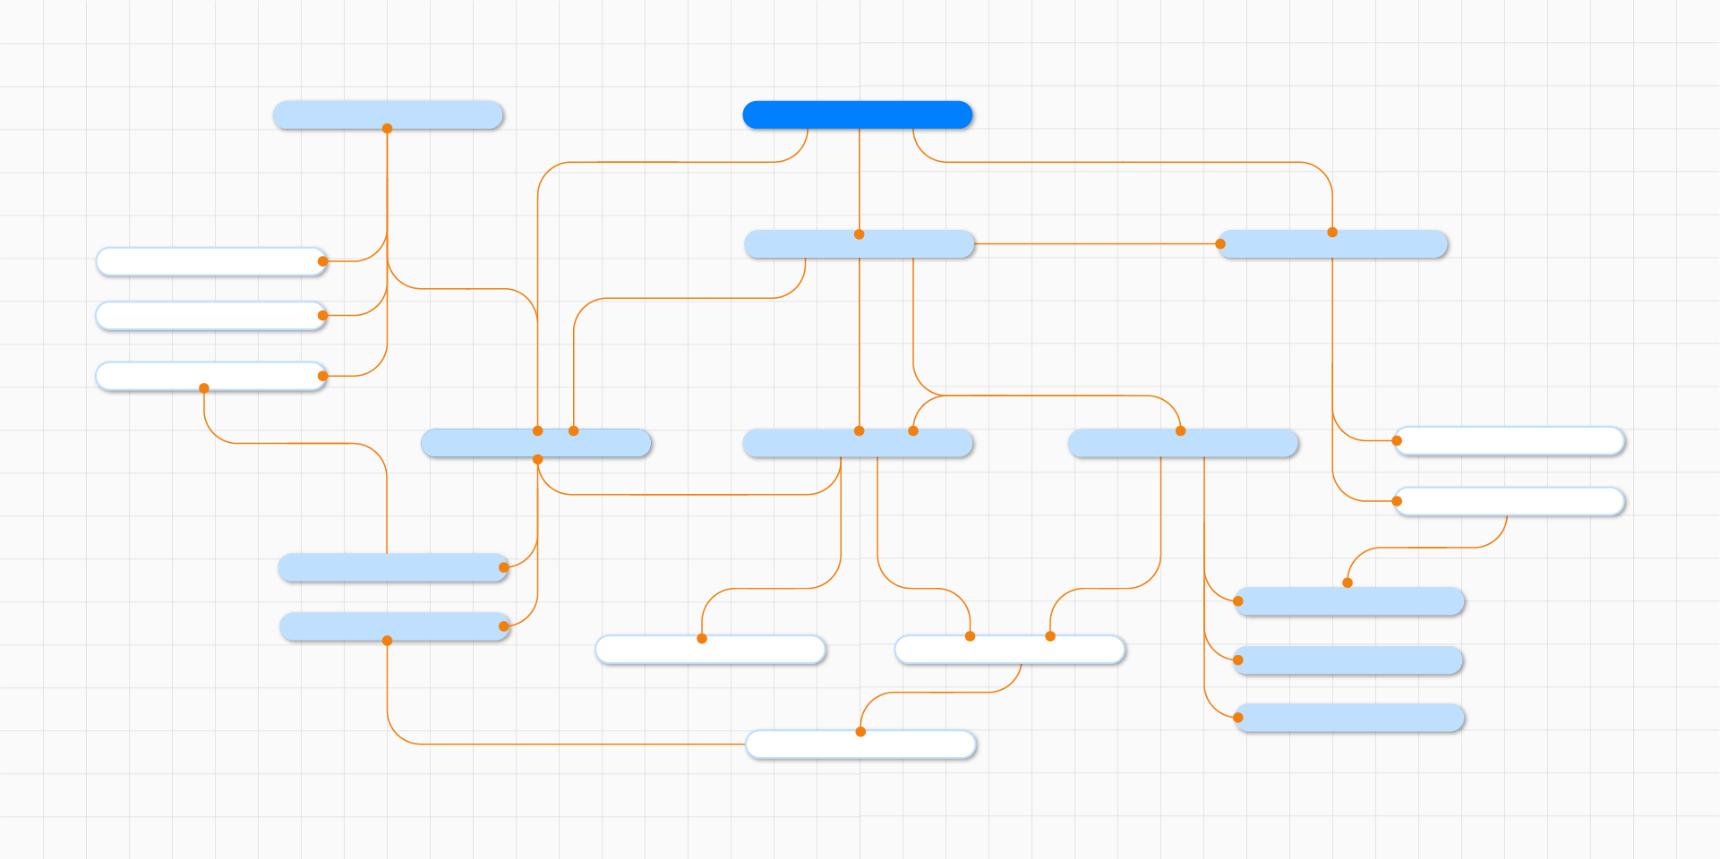
Orchestration
Orchestration: Coordinating tasks in a data pipeline so they run in the right order and reliably.

Slide 7
Orchestration Types
Schedule-based: Run at fixed intervals (daily, hourly).
Example: ETL pipelines run at 9 AM, Transformation runs at 10 AM, data serving runs at 11 AM.
Trigger-based: Run when a certain event occurs.
File arrival: New file detected → pipeline triggers.
Database trigger: New row inserted → pipeline triggers.
API/webhook trigger: External signal → pipeline triggers.

Slide 8
Orchestration Types
Schedule based in simplest option, however not ideal.
What if the latency in pipelines make them take more time. E.g., ETL doesn’t finish before 10 AM.
Latency is more than what expected. You need to allow extra room than what you need.
Trigger based pipeline is more difficult and typically needs tools.

Slide 9
Orchestration Types
Schedule based in simplest option, a simple Cron job can run it in a virtaul machine.
0 2 * * * /usr/bin/python3 /home/user/scripts/etl_pipeline.py
This cron job runs every day at 2:00 AM.
However not ideal.
What if the latency in pipelines make them take more time. E.g., ETL doesn’t finish before 10 AM.
Latency is more than what expected. You need to allow extra room than what you need.
Trigger based pipeline is more difficult and typically needs tools.

Slide 10
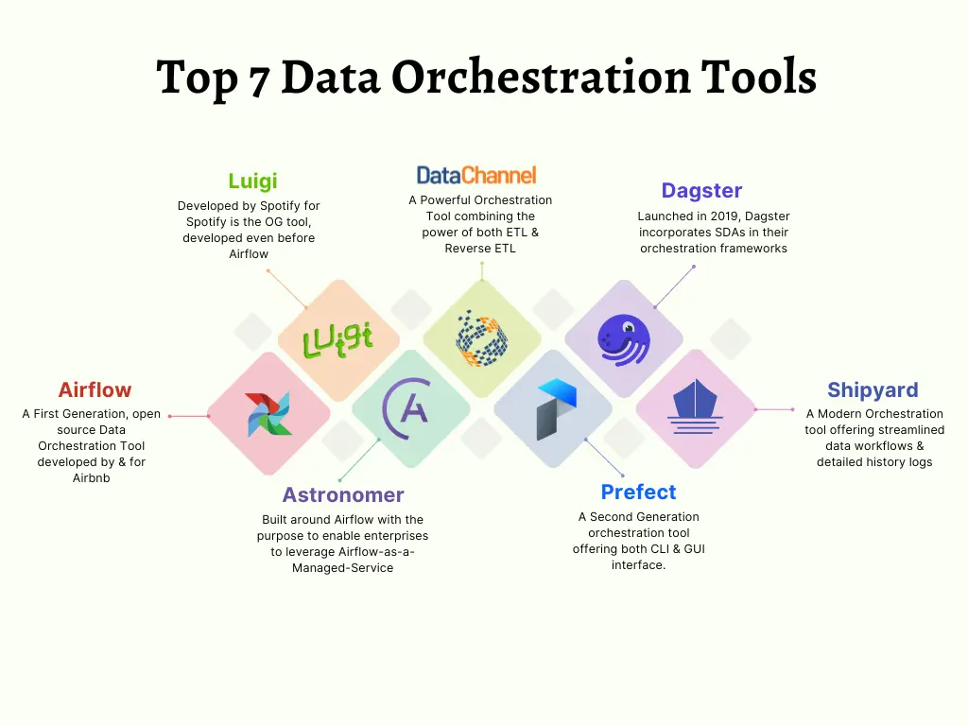
Orchestration Tools
No need to learn these for the exam. Airflow is the most commonly used.

Slide 11

Airflow
Definition: A platform to programmatically schedule and monitor workflows (data pipelines).
Pipelines are DAGs (Directed Acyclic Graphs) – tasks with dependencies.
Pros
Manages task dependencies
Handles retries & failures
Provides monitoring & logs

Slide 12
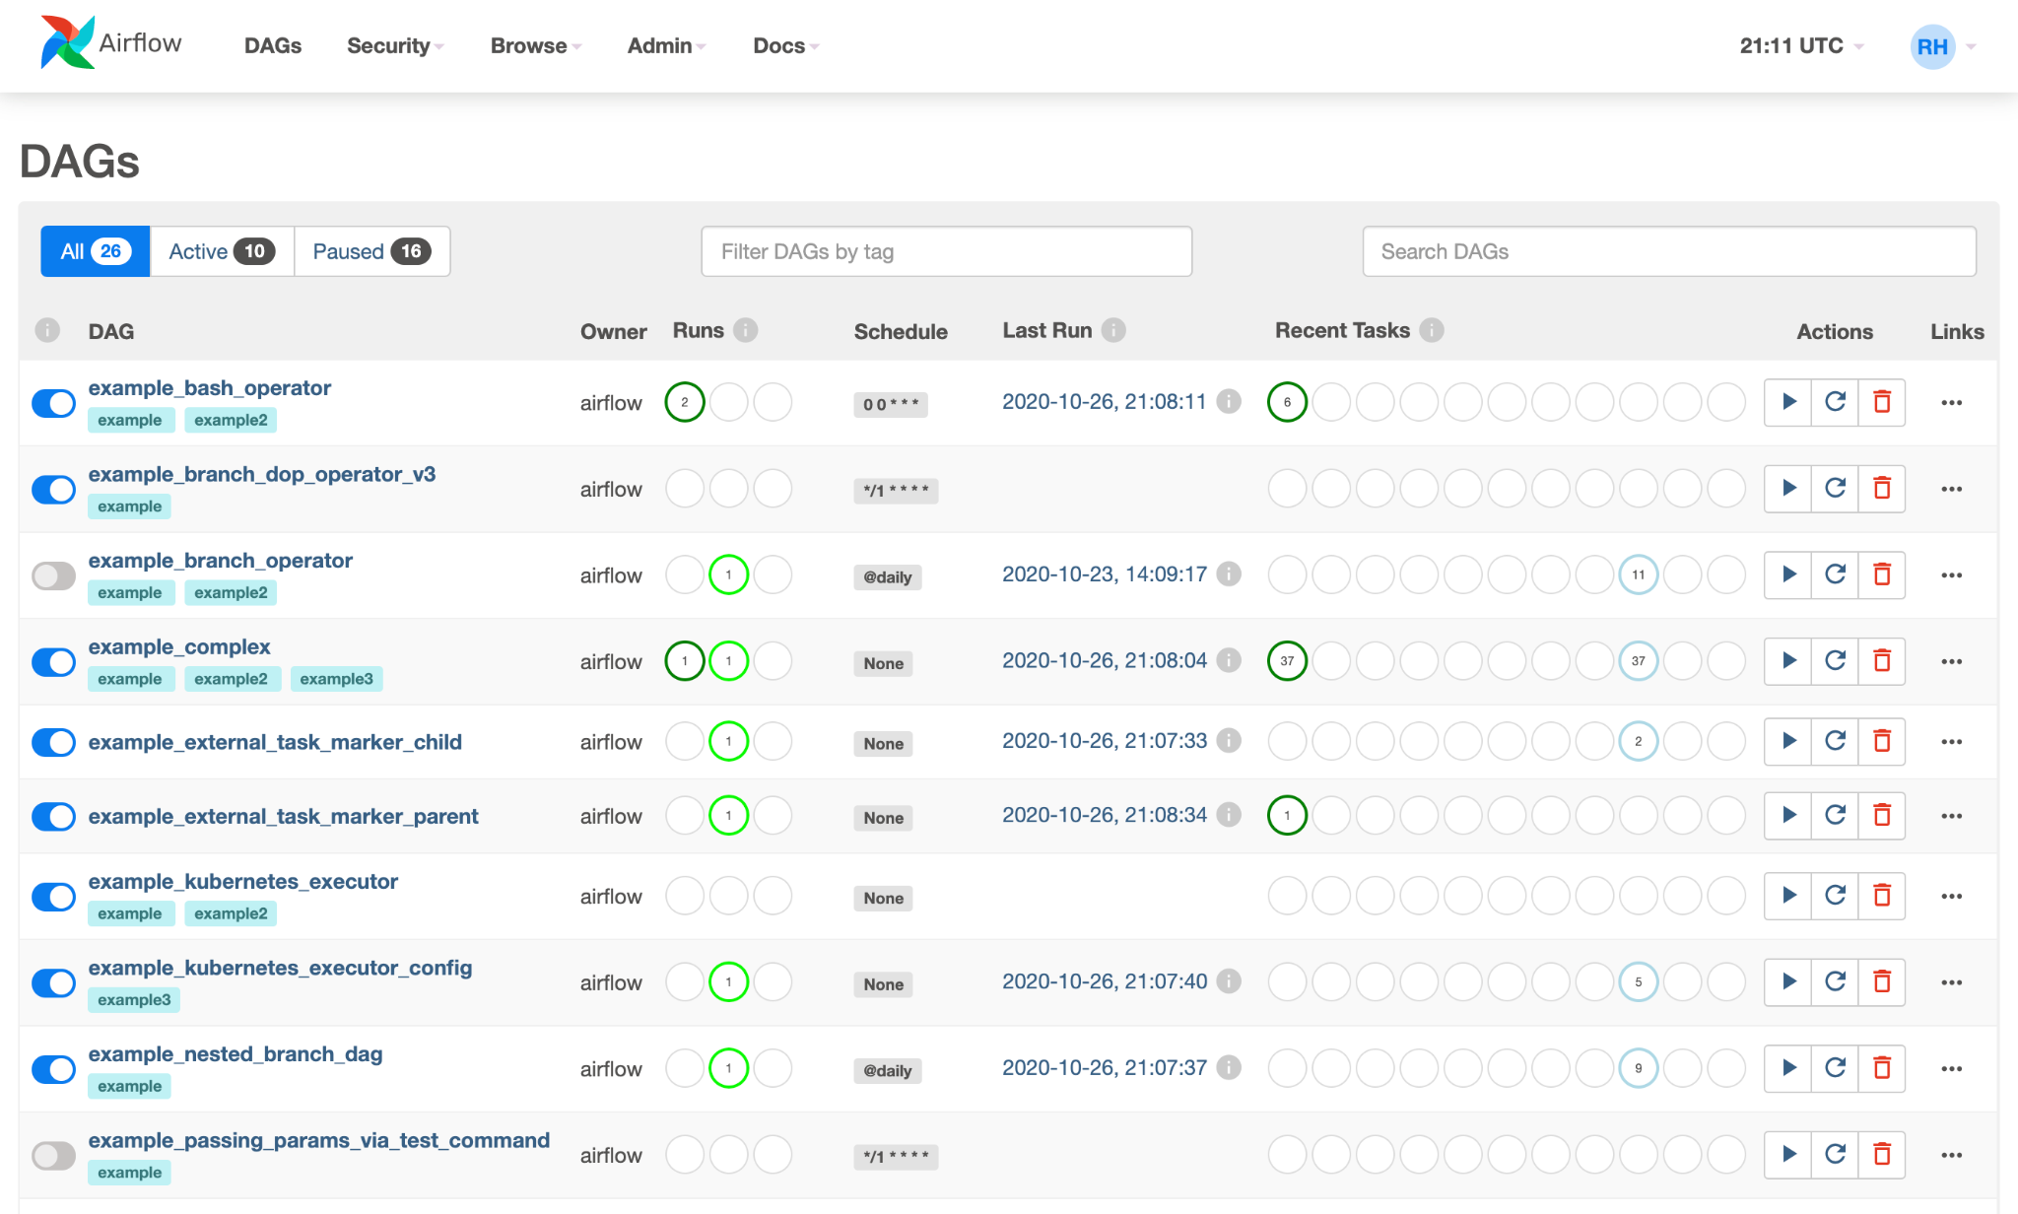
Airflow Job UI

Slide 13
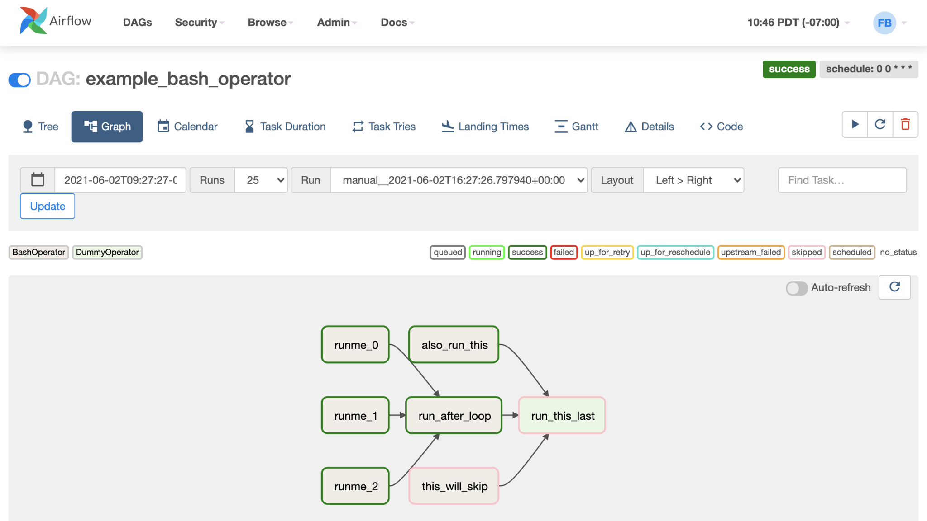
Airflow DAG UI

Slide 14
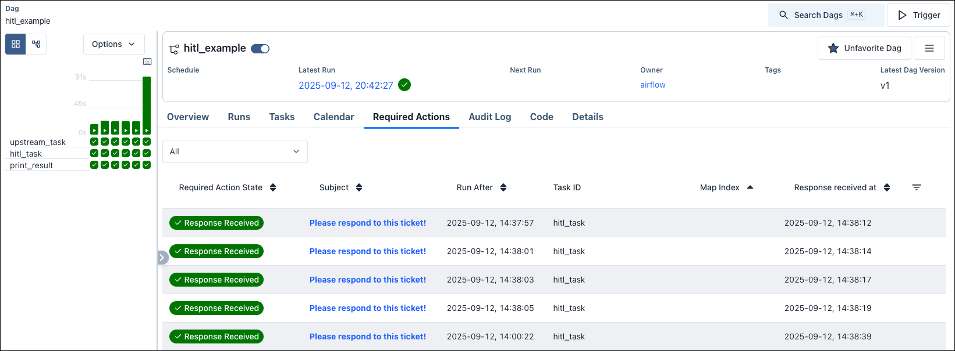
Airflow Monitoring UI

Slide 15
Airflow Code Example
from airflow import DAG
from airflow.operators.python_operator import PythonOperator
from datetime import datetime
from jobs import extract, transform, load
with DAG('etl_dag', start_date=datetime(2025,11,23), schedule_interval='@daily') as dag:
t1 = PythonOperator(task_id='extract', extract)
t2 = PythonOperator(task_id='transform', transform)
t3 = PythonOperator(task_id='load', load)
t1 >> t2 >> t3

Slide 16
Airflow Code Example
default_args = {
'owner': 'airflow',
'depends_on_past': False,
'email_on_failure': True,
'email': ['data-team@example.com'],
'retries': 2,
'retry_delay': timedelta(minutes=5)
}
with DAG(
'advanced_etl_dag',
default_args=default_args,
description='Advanced ETL with triggers, branching, retries',
schedule_interval='@daily',
start_date=days_ago(1),
catchup=False,
) as dag:
….
wait_for_file >> t1_extract >> t2_transform >> t3_load >> t4_quality_check
t4_quality_check >> t5_notify_fail >> t7_end
t4_quality_check >> t6_notify_success >> t7_end

Slide 17
Orchestration Note
Most data pipelines benefit from using both schedule-based and trigger-based orchestration. The schedule controls the overall cadence of the pipeline, such as running a DAG daily, while triggers and dependencies manage the flow of tasks within each stage.
It’s important to note that an entire enterprise pipeline cannot fit into a single DAG. Pipelines are usually broken into stages or sub-DAGs, where each stage:
Handles a logical portion of the pipeline
Manages internal task dependencies and retries

